Slide 1
Friday, January 27, 2017
Write In Your Agenda:
Write In Your Monitoring Log:
CW:
A New Critter & Its Niche.
Food Chain Practice.
Biotic vs Abiotic Poster
HW:
Have Monitoring Log signed.
Study for Ecology Quiz on Monday, January 30.
Response to Warm-Up:
Name 2 biotic and 2 abiotic “things.”
You will need:
Pencil.
Hand in Ecology Crossword Puzzle!

Slide 2
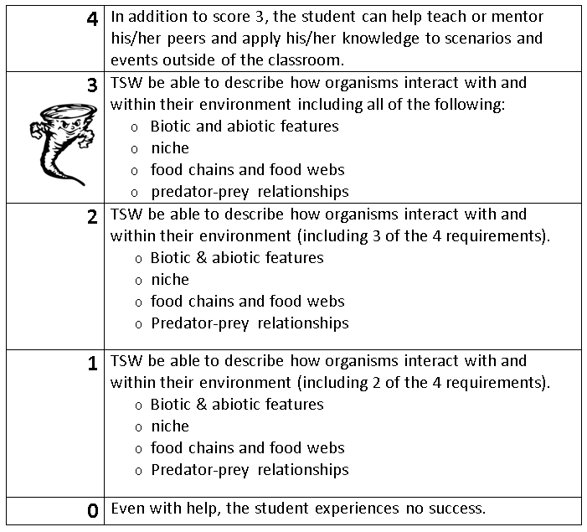
Learning Goal and Scale
TSW be able to describe how organisms interact with and within their environment (including biotic and abiotic features, niche, food chains & webs, and predator-prey relationships).

